Slide 1
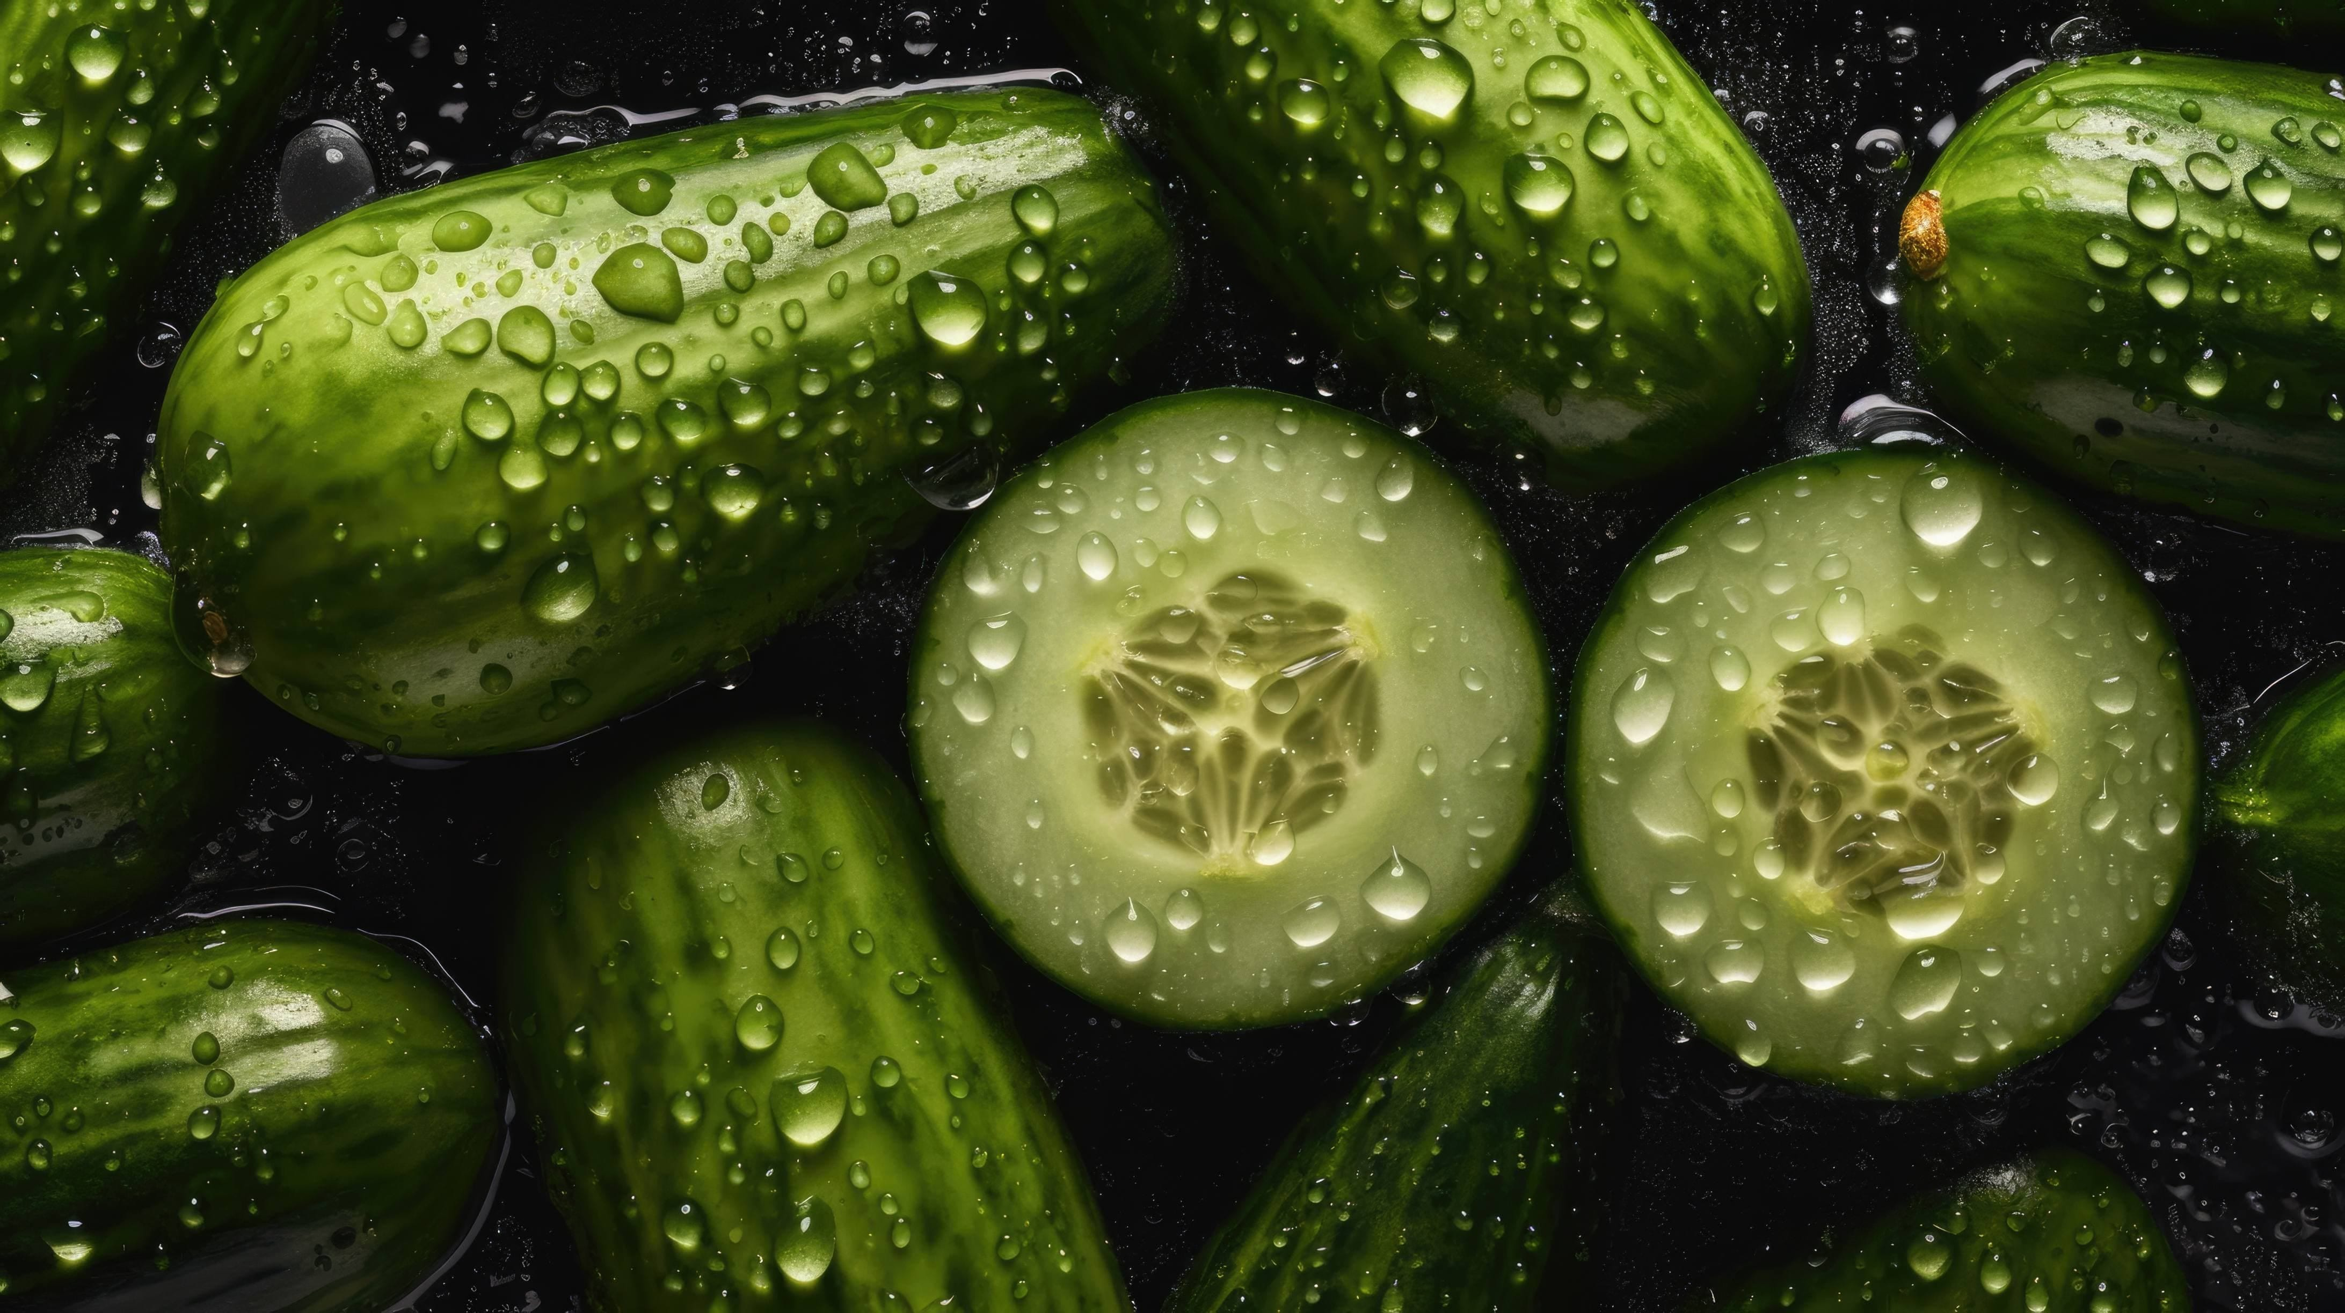
Synergetic Innovation in Gherkin Cultivation
Project ID : R24-010
Ino Agri Mobile App

Slide 2
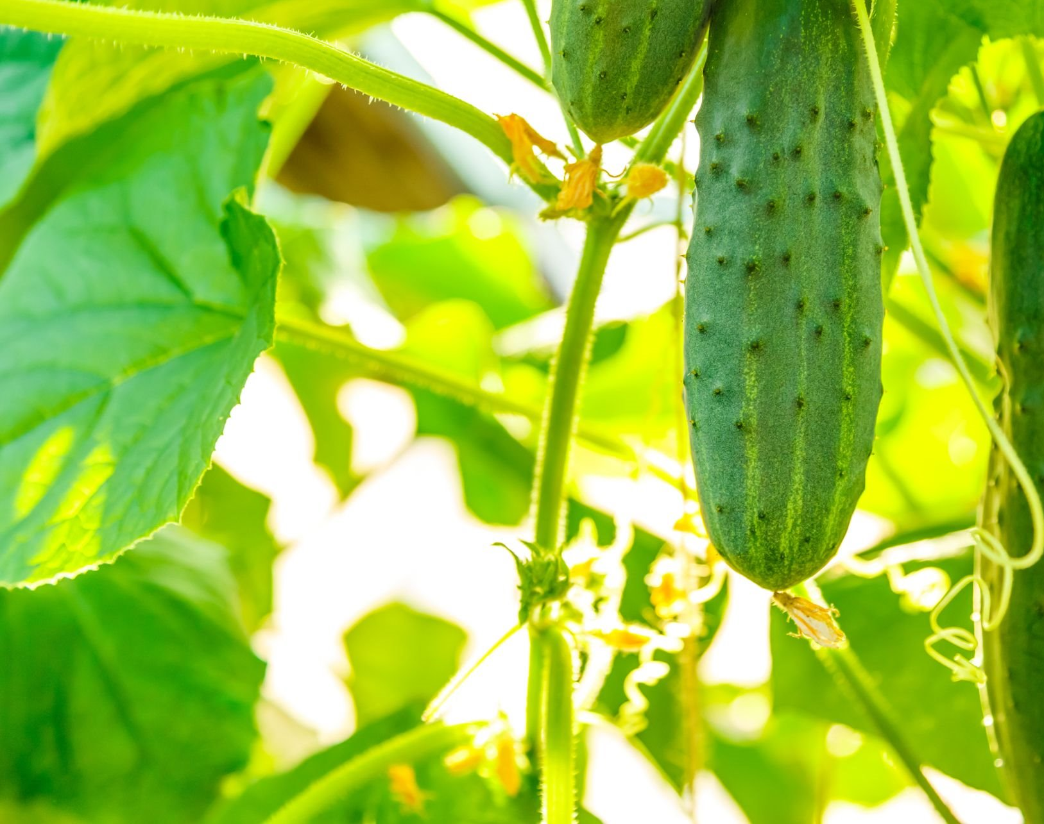
Introduction
What is gherkin and why gherkin cultivation is Important to Sri Lanka?
Overview of gherkin cultivation in Sri Lanka
What are the gherkin cultivation problem areas?
Why should gherkin cultivation need and automated system?
Benefits of automated system for gherkin cultivation

Slide 3
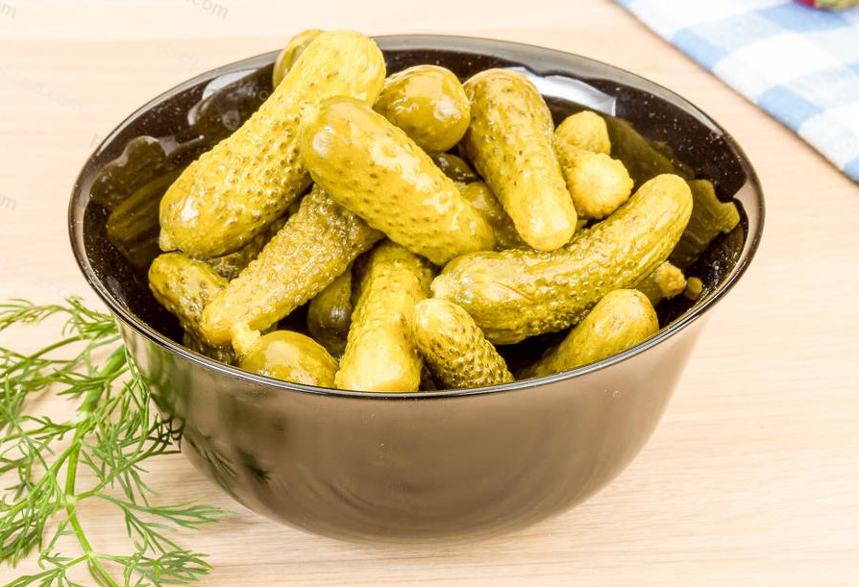
Research Problem
The research problem centers on key challenges within Sri Lanka's gherkin industry.
Issues include subjective, identifying diseases methods, insufficient pest identification, inaccurate market price predictions, and inadequate fertilizer stock management.
Moreover, current farm planning lacks integration with immersive technologies, hindering optimal cultivation practices.
The research aims to address these challenges by proposing technical solutions that leverage machine learning, image processing, and virtual reality, ultimately enhancing the industry's efficiency and sustainability.

Slide 4

Objectives of Study
Main Objectives
Transform the Gherkin planting Industry through an Innovative Multifunctional System
Sub Objectives
Pest control system with intelligent identification techniques for effective pest management.
Predictive maintenance system forecasts fertilizer stock levels for effective management.
Identify diseases and predict solutions for effective disease management strategies.
Predict the market price for gherkins country-wise using historical data, weather, global supply and demand, and economy.

Slide 5

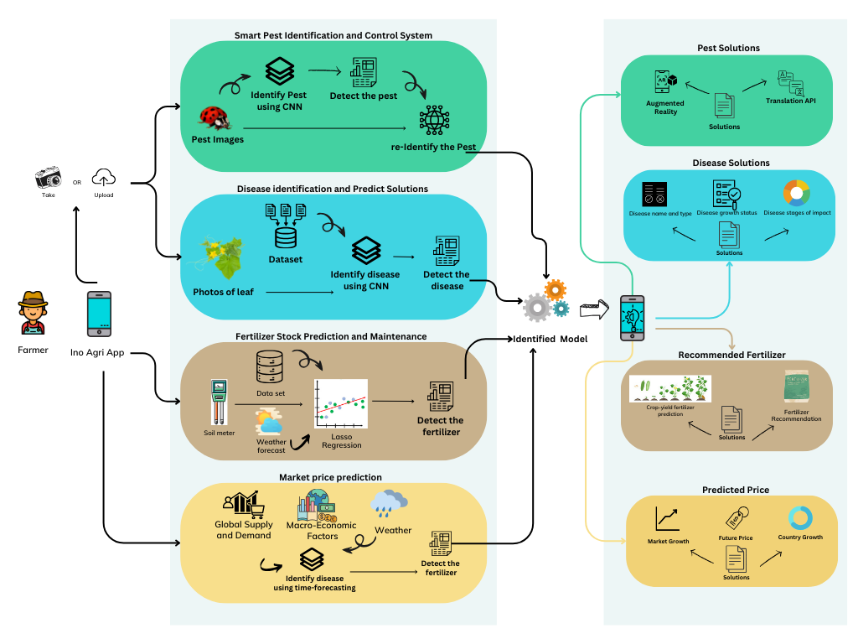
System Diagram

Slide 6

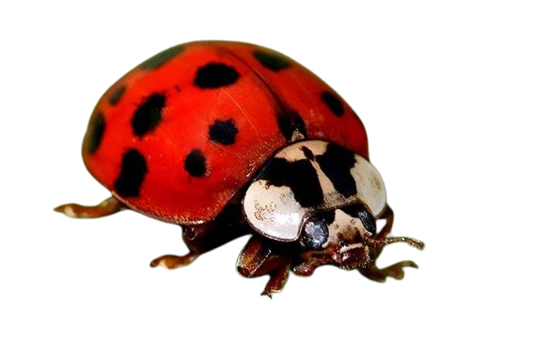
IT21042560 | Jinasena H.D.S.S Specialization : Software Engineering
Component 1 - Smart Pest Identification and Control System
IT21042560 | Jinasena H.D.S.S | R24-010

Slide 7
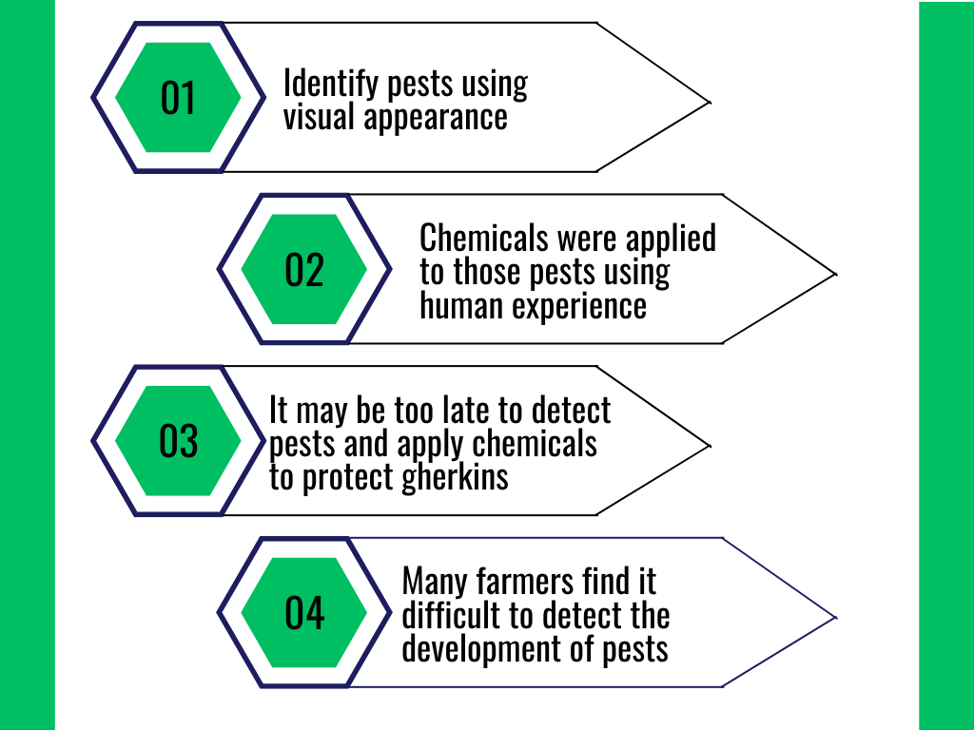
Background of the Study
In the past, pest identification relied on visual observation and traditional methods struggle to predict the duration and speed of pest population growth and feeding habits.
pest control relied on experiential solutions. New farmers lack knowledge, leading to delayed identification and reduced harvests.
Farmers lacking technical knowledge struggle to adopt new technologies for pest management, hindering effective solutions and impacting overall harvest yields.
IT21042560 | Jinasena H.D.S.S | R24-010

Slide 8
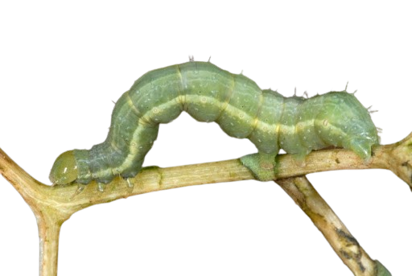


Research Problem
How can machine learning be utilized to achieve high accuracy in identifying pests, and what factors need to be considered, such as , model training, and real-time application in agricultural systems?
How can a farmer-friendly system be developed to recommend pest control chemicals and solutions, taking into account effectiveness, sustainability, environmental impact, and personalized approaches in alignment with pest growth dynamics?
IT21042560 | Jinasena H.D.S.S | R24-010

Slide 9


Research Gap of the Study
Application Reference | Research 1 | Research 2 | Research 3 | Propose System
Pest identification
Pest re-identification and detection
Provide solutions to pests
Augmented reality pest solutions
Translate the solutions
IT21042560 | Jinasena H.D.S.S | R24-010

Slide 10




Specific and Sub Objective
Identification of Gherkins Pests.
Pest re-identification and detection
Smart Pest Identification and Control System
Create AR based pest Visualization
Provide Translate solutions to the pests
IT21042560 | Jinasena H.D.S.S | R24-010

Slide 11
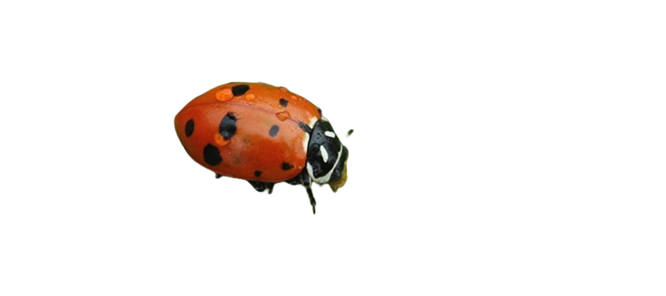


Methodology
Functional Requirements
identify accurate pest
provide solutions for pest infections
User-friendly language for farmers
Non-functional requirements
Performance
Flexibility
Eazy to learn for new farmers
React Native
Node
Expo
Python
MongoDB
GitHub
Machine Learning
Google translate API
COMPONETE DIAGRAM
TECHNOLOGIES
REQUIREMENTS
IT21042560 | Jinasena H.D.S.S | R24-010

Slide 12
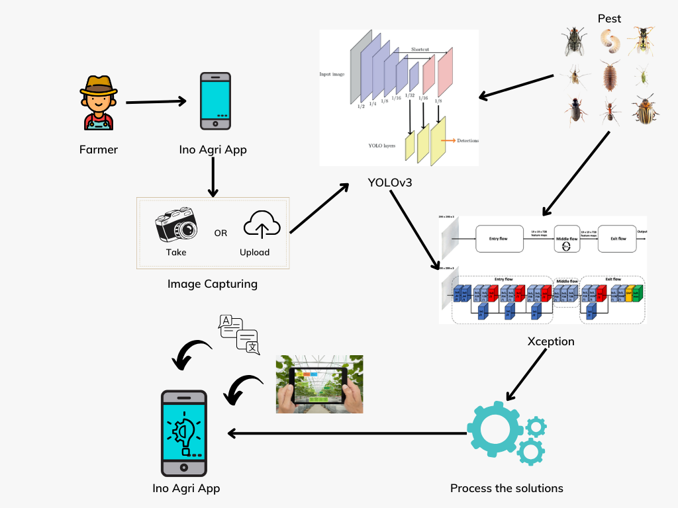
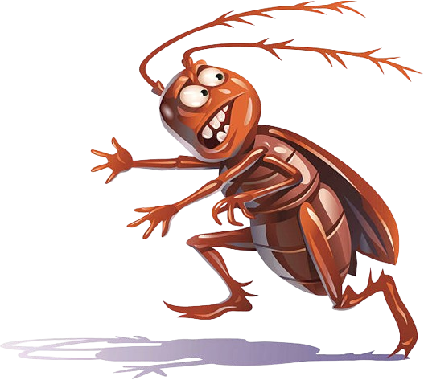
Component Diagram
IT21042560 | Jinasena H.D.S.S | R24-010

Slide 13
Novelty
Introduce the capability to predict pests using two models of gherkin plants.
Introducing new functionality to provide a user-friendly solution using augmented reality and translation.
IT21042560 | Jinasena H.D.S.S | R24-010

Slide 14
Completion of the project
Process | Dec | Jan | Feb | Mar | Apr | May | Jun | Jul | Aug | Sep | Oct | Nov
Research group formation
Selection of research topic
Feasibility and background study
Supervisor and co-supervisor selection
Topic registration
Topic assessment submission
Project charter submission
Proposal presentation
Proposal report submission
Implementation of the project(50%)
Progress presentation 01
Prepare and submit research paper
Implementation of the project(90%)
Progress presentation 02
Project completion
Final Presentation
Final Report
IT21042560 | Jinasena H.D.S.S | R24-010

Slide 15
References
[1] Nitharshana Mahenthira, "Smart Pest Management: An Augmented Reality-Based Approach for an Organic Cultivation," in IEEE, Ankara, Turkey, 2021.
[2] | Ascharya Soni , "Pest Identification and Control using Deep Learning and Augmented Reality," in IEEE, 2022.
[3] Hiroaki Kuzuhara, "Insect Pest Detection and Identification Method Based on Deep Learning," in Society of Instrument and Control Engineers of Japan (SICE), Chiang Mai, Thailand, 2020.
IT21042560 | Jinasena H.D.S.S | R24-010

Slide 16
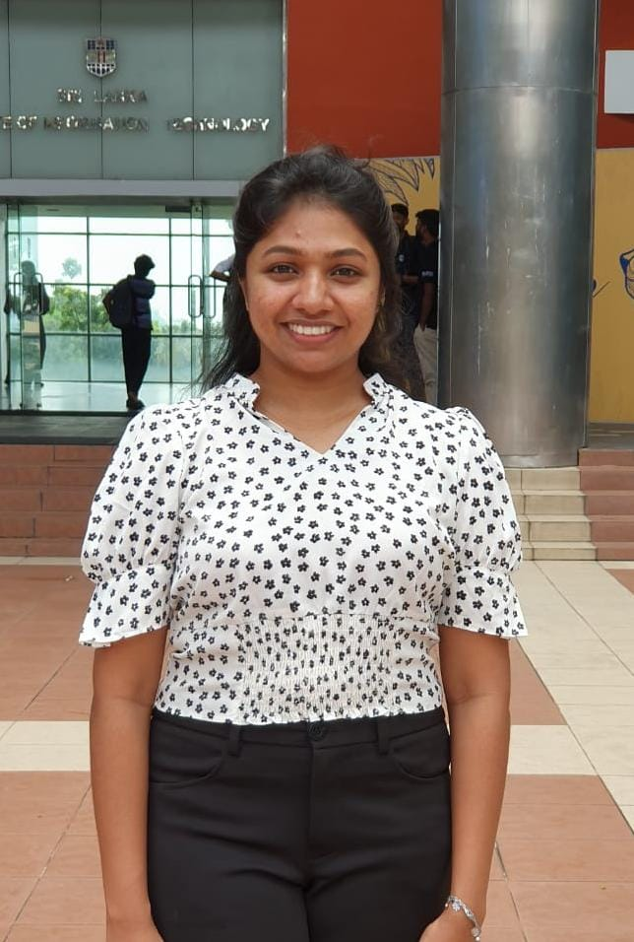
IT20254216 | Dayarathna T.W.K.D.A. SPECIALIZATION : SOFTWARE ENGINEERING
Component 2 : Fertilizer Stock Prediction and Maintenance
IT20254216 | Dayarathna T.W.K.D.A. | R24-010

Slide 17
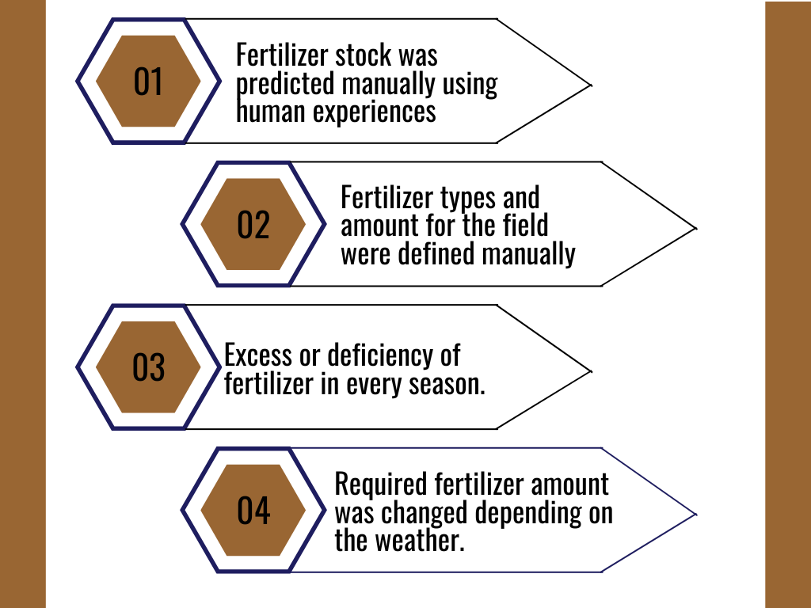
Background of the Study
In the past, the fertilizer types needed to the crop were predicted manually by the human experiences.
The fertilizer percentage of the soil was not measured before applying the fertilizer to the crop.
Therefore, the fertilizer stock was excessive or deficient in every season .
The required stock was changed depending on weather conditions because of the lack of knowledge about weather forecasting in the season.
IT20254216 | Dayarathna T.W.K.D.A. | R24-010

Slide 18

Research Problem
How to reduce the cost by avoiding excess or deficiency.
How to predict the fertilizer stock according to the future weather forecast.
How to optimize the applied amounts of fertilizer for the plantation
How to give a farmer friendly real-time solution using machine learning techniques
How to maintain the stock according to the requirements.
IT20254216 | Dayarathna T.W.K.D.A. | R24-010

Slide 19
Research Gap of Study
Application Reference | Research 1 | Research 2 | Research 3 | Propose System
Getting real-time inputs by a soil meter.
Recommending fertilizer types.
Predicting the fertilizer according to the weather forecast.
Optimize the fertilizer amounts
Predict the fertilizer stock for the season for a specific plantation.

Slide 20





Specific and Sub Objectives
Recommending the suitable fertilizers to the soil
Fertilizer stock recommendation, prediction and optimization
Predicting the crop-yield fertilizer stock
Create a farmer-friendly application
Predicting the fertilizers according to weather forecast

Slide 21
Methodology
React Native
Node
Expo
Python
Jupyter Notebook
MongoDB
GitHub
Machine Learning
Weather API
COMPONETE DIAGRAM
TECHNOLOGIES
REQUIREMENTS
Functional Requirements
Identify the fertilizer percentages in the soil
Predict the fertilizer requirement according to weather forecast
Suggest fertilizers and stock.
Non-functional requirements
Performance
Reliability
User friendliness
ITXXXXXXXX | <<Student Name>> | <<Project ID>>

Slide 22
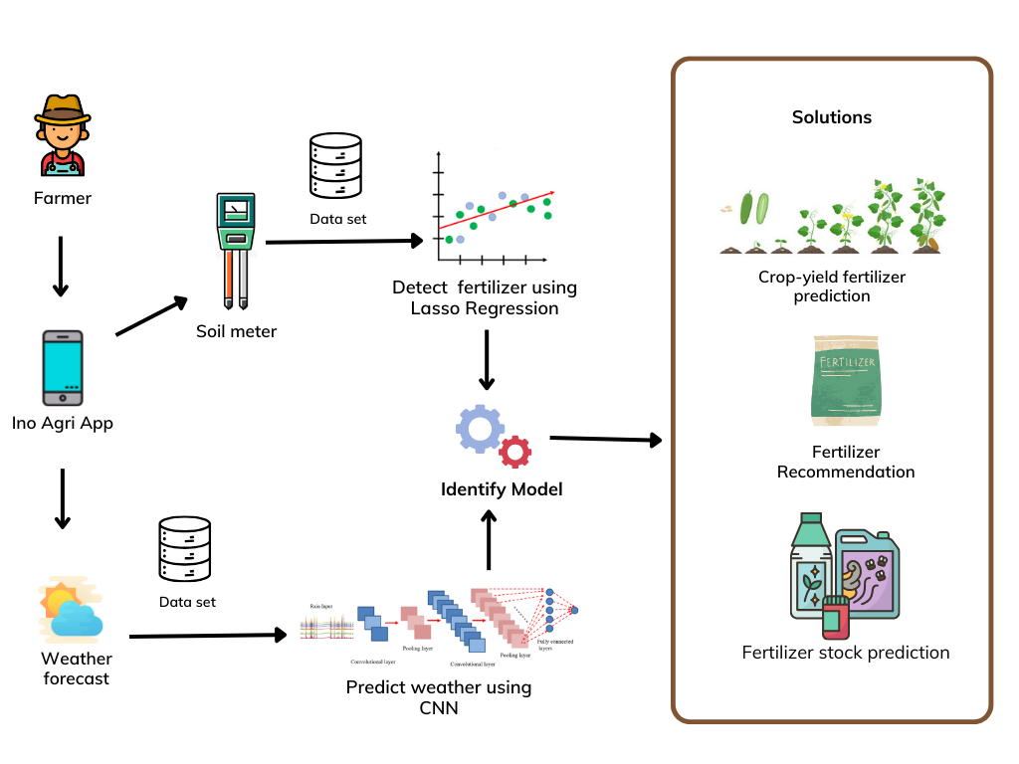
Component Diagram

Slide 23
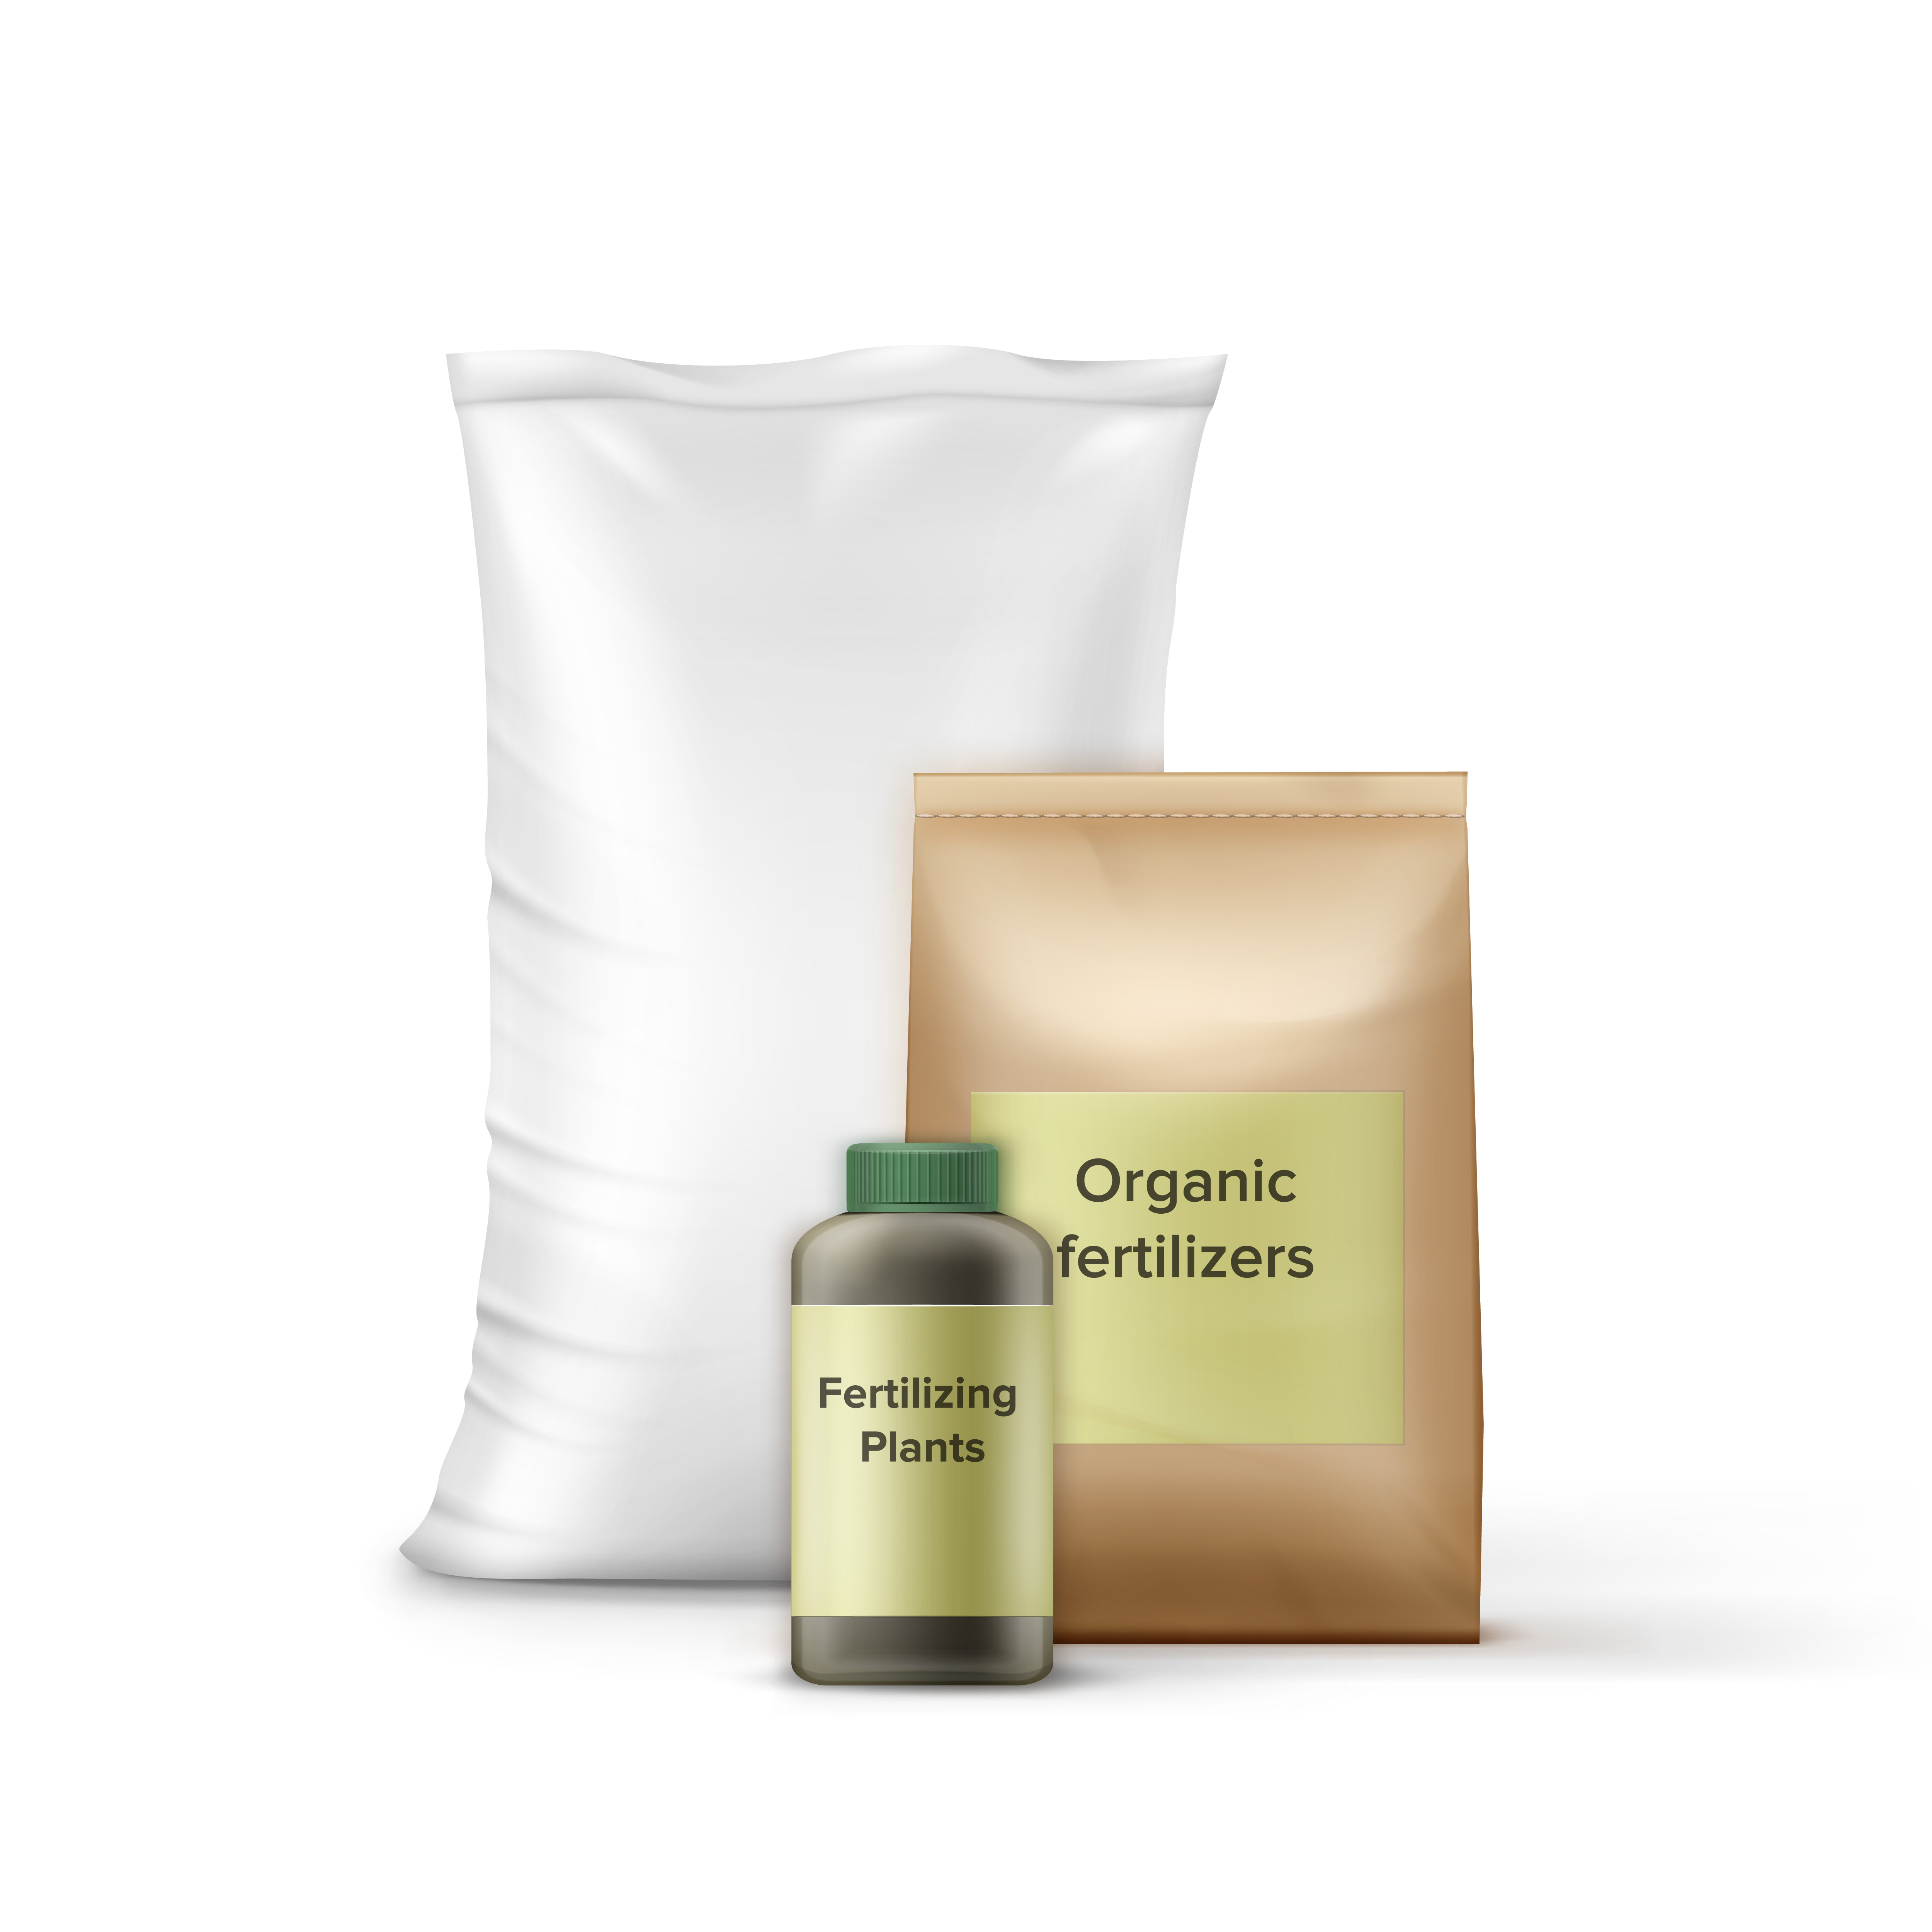
Novelty
Introduce an integrated system with fertilizer prediction, recommendation and optimization combining with real-time weather forecast.
Introducing new functionalities to recommend the suitable fertilizer types and predict the seasonal fertilizer stock for a specific farm

Slide 24
Completion of the project
Process | Dec | Jan | Feb | Mar | Apr | May | Jun | Jul | Aug | Sep | Oct | Nov
Research group formation
Selection of research topic
Feasibility and background study
Supervisor and co-supervisor selection
Topic registration
Topic assessment submission
Project charter submission
Proposal presentation
Proposal report submission
Implementation of the project(50%)
Progress presentation 01
Prepare and submit research paper
Implementation of the project(90%)
Progress presentation 02
Project completion
Final Presentation
Final Report
IT20254216 | Dayarathna T.W.K.D.A. | R24-010

Slide 25
References
[1]K. Monika, B. Ramprakash, S. Muthuramalingam, and K. Mirdula, “Crop Fertilizer Prediction using Regression analysis and Machine Learning algorithms,” IEEE Xplore, Dec. 01, 2022. https://ieeexplore.ieee.org/document/10072846
‌
[2]K. P. K. Devan, B. Swetha, Puzhakkal Sruthi, and S. Varshini, “Crop Yield Prediction and Fertilizer Recommendation System Using Hybrid Machine Learning Algorithms,” Apr. 2023, doi: https://doi.org/10.1109/csnt57126.2023.10134662.
[3]Sugantha Priyadharshini. P, Birundha. S, and Pavithra. R, “Deep Learning in Agronomic Forecast,” 2021 5th International Conference on Electronics, Communication and Aerospace Technology (ICECA), Dec. 2021, doi: https://doi.org/10.1109/iceca52323.2021.9675858.
‌

Slide 26
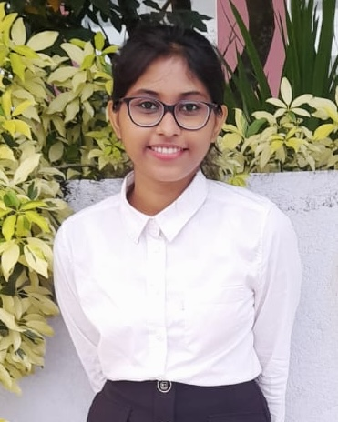
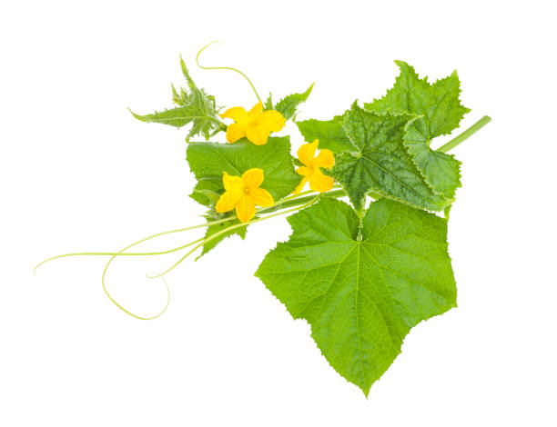
IT21022388 | PERERA H.M.A.G Specialization : Information technology
Component 3 : Disease Identification and Management System For Gherkin Plant
IT21022388 | PERERA H.M.A.G | R24 - 010

Slide 27
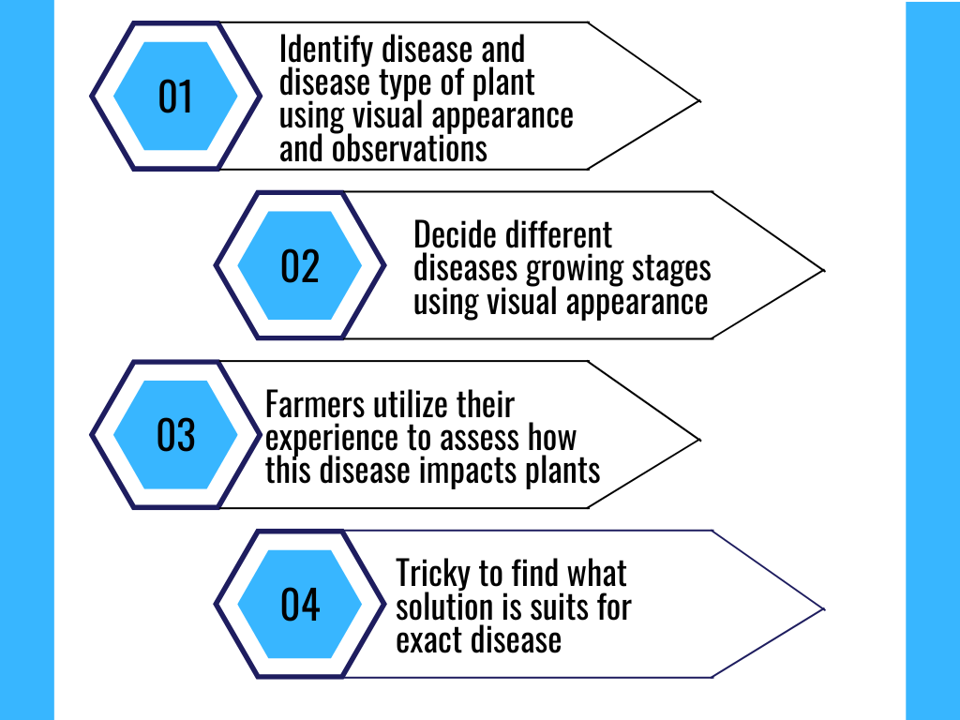
Background of the Study
Farmers rely on visual appearance and keen observations to identify diseases affecting their plants.
Farmers examine symptoms such as discoloration, lesions, or unusual growth patterns to determine the presence of a disease.
This process often involves experimentation, consultation with experts, and adaptation of management practices to suit the unique characteristics of each disease.
IT21022388 | PERERA H.M.A.G | R24 - 010

Slide 28

Research Problem
How can we develop a user-friendly system that accurately identifies and categorizes diseases in gherkin plants using advanced image processing techniques?
How can the system predict disease progression stages and suggest effective management strategies?
How can we optimize this system to enhance accuracy, efficiency, and performance to meet the varied requirements of growers and agricultural stakeholders?
IT21022388 | PERERA H.M.A.G | R24 - 010

Slide 29

Research Gap of the Study
Application Reference | Research 1 | Research 2 | Research 3 | Research 4 | Propose System
Disease identification
Disease Classification according to the disease type
Predict the impact level of disease to the plant and give it as a status
Give the solutions to the diseases and search from the internet
forecasting the disease stage as either initial, intermediate, or advanced
IT21022388 | PERERA H.M.A.G | R24 - 010

Slide 30
Specific and Sub Objective
Disease Identification and Classification of gherkin plant
Predict the impact level of disease to the plant
Disease Identification and Management System
Create a model for Disease Stage Forecasting
Create a model for Disease Stage Forecasting
IT21022388 | PERERA H.M.A.G | R24 - 010

Slide 31
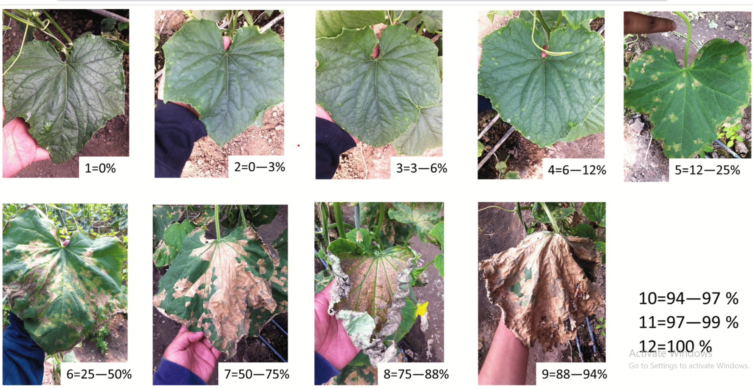
Novelty
Introduce the capability of predicting the impact level of diseases on gherkin plants.
Critical Impact
Moderate Impact
Minimal Impact
Introducing a novel functionality to forecast diseases stage in different stages levels.
Early stage, Mid Stage, Late Stage
IT21022388 | PERERA H.M.A.G | R24 - 010

Slide 32
Methodology
Functional Requirements
Real-time image capture and preprocessing capabilities.
Implementation of deep learning models for disease identification and classification.
User-friendly interface for easy operation and navigation.
Non-functional requirements
High accuracy rates
Fast response times
Userfriendly to farmers
Technologies
React Native
Node
Expo
Python
MongoDB
GitHub
Deep learning
Google colab
Google Cloud Vision API
COMPONETE DIAGRAM
TECHNOLOGIES
REQUIREMENTS
IT21022388 | PERERA H.M.A.G | R24 - 010

Slide 33
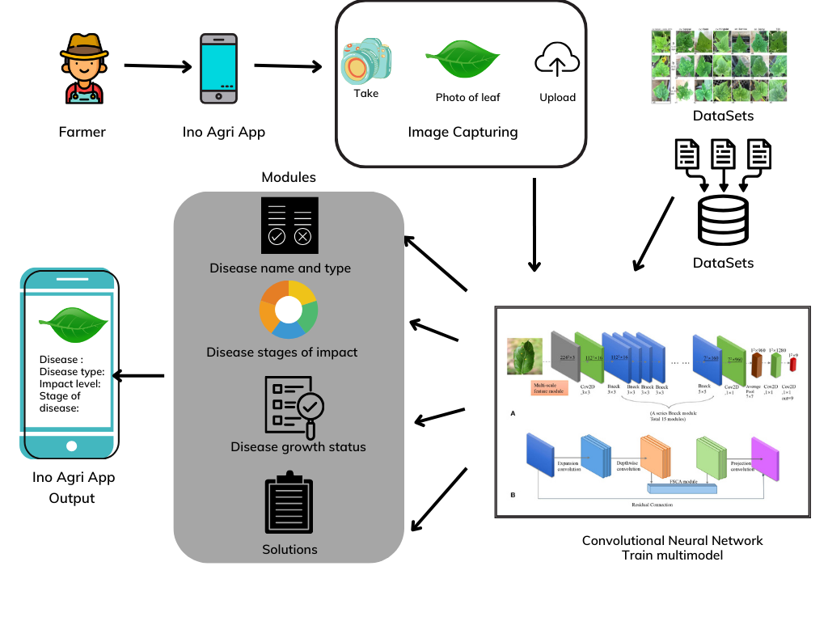
Component Diagram
IT21022388 | PERERA H.M.A.G | R24 - 010

Slide 34
Completion of the project
Process | Dec | Jan | Feb | Mar | Apr | May | Jun | Jul | Aug | Sep | Oct | Nov
Research group formation
Selection of research topic
Feasibility and background study
Supervisor and co-supervisor selection
Topic registration
Topic assessment submission
Project charter submission
Proposal presentation
Proposal report submission
Implementation of the project(50%)
Progress presentation 01
Prepare and submit research paper
Implementation of the project(90%)
Progress presentation 02
Project completion
Final Presentation
Final Report
IT21022388 | PERERA H.M.A.G | R24 - 010

Slide 35
References
[1] J. Zhang, Y. Rao, C. Man, Z. Jiang, and S. Li, "Identification of cucumber leaf diseases using deep learning and small sample size for agricultural Internet of Things," IEEE Internet Things J., vol. 8, no. 8, pp. 6545-6554, Aug. 2021, doi: 10.1109/JIOT.2021.3071746.
[2] O. Metin, "Automatic Detection and Classification of Mildew Disease in Cucumber Using Deep Learning Algorithms," Journal Title, volume(issue), page range, year.
[3] M. J. Mia, S. K. Maria, S. S. Taki, and A. A. Biswas, "Cucumber disease recognition using machine learning and transfer learning," Bulletin of Electrical Engineering and Informatics, vol. 10, no. 6, pp. 3432-3443, Dec. 2021, doi: 10.11591/eei.v10i6.3096.
[4] J. M. Kable, "Key to Common Problems of Cucumbers," University of Maryland Extension, Feb. 18, 2024. [Online]. Available: https://extension.umd.edu/resource/key-common-problems-cucumbers/. [Accessed: Feb. 20, 2024].
IT21022388 | PERERA H.M.A.G | R24 - 010

Slide 36


IT21045530 | Nissanka k g t r k Specialization : Information technology
Component 4 – Market price prediction
IT21045530 | Nissanka K.G.T.R.K | R24-010

Slide 37
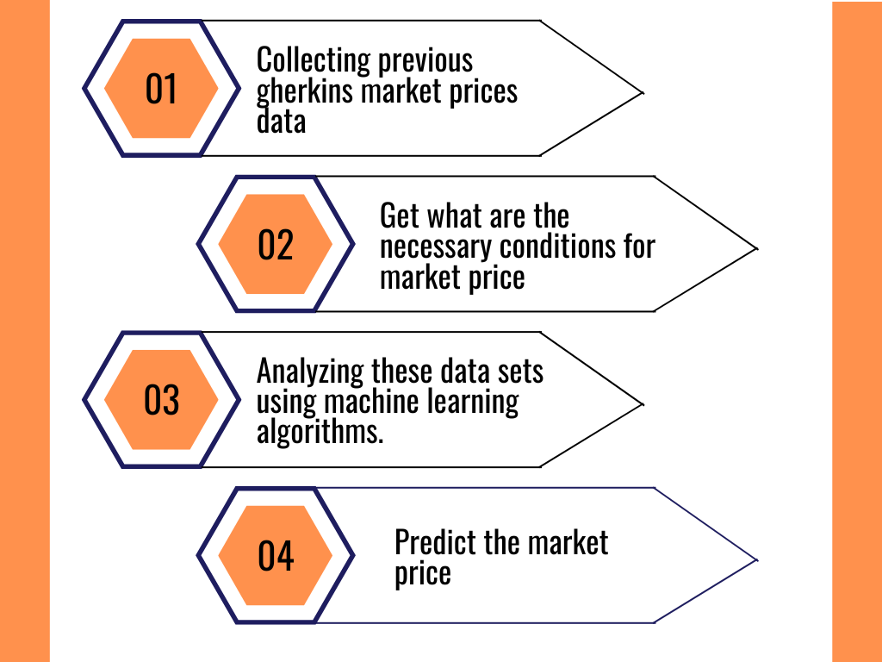
Background of the Study
The primary objective is to implement a novel predictive model to predict the market price for gherkins.
This involves country-wise forecasting of export demand by integrating historical data with future weather information, global demand patterns, Supply and Demand and meteorological data specific to each export destination.
The solution aims to continuously refine predictive models using machine learning and statistical techniques, with a time forecasting algorithm for dynamic adjustments based on real-time market conditions.
IT21045530 | Nissanka K.G.T.R.K | R24-010

Slide 38

Research Problem
Despite the significant advancements in predictive modeling techniques, there remains a critical need to develop and refine predictive models specifically tailored for forecasting the market price of gherkins.
This aims to address the challenge of accurately predicting gherkins' market prices by integrating various data sources, including historical data, future weather information, global demand patterns, and meteorological data specific to each export destination.
IT21045530 | Nissanka K.G.T.R.K | R24-010

Slide 39


Research Gap of the Study
Application Reference | Research 1 | Research 2 | Research 3 | Propose System
Forecasting the market price
Market price prediction for broader agricultural products
Lack of attention to longer-term forecasting horizons beyond short-term predictions.
Predicting price by countries
Inadequate transparency and justification for chosen models and parameters.
IT21045530 | Nissanka K G T R K | R24-010

Slide 40
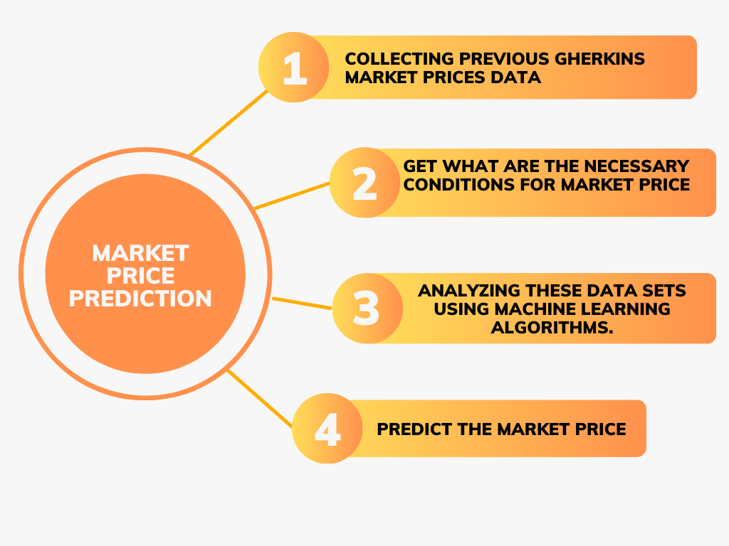
Specific and Sub Objective
IT21045530 | Nissanka K G T R K | R24-010

Slide 41
Methodology
Functional Requirements
Predict price using historical data, weather, global supply and demand, and economy.
Divide predicted price data sets into the country-wise.
Non-functional requirements
Performance
Reliability
User friendliness
Technologies
React Native
Node
Expo
Python
MongoDB
GitHub
Machine Learning
Deep learning
COMPONETE DIAGRAM
TECHNOLOGIES
REQUIREMENTS
IT21045530 | Nissanka K G T R K | R24-010

Slide 42
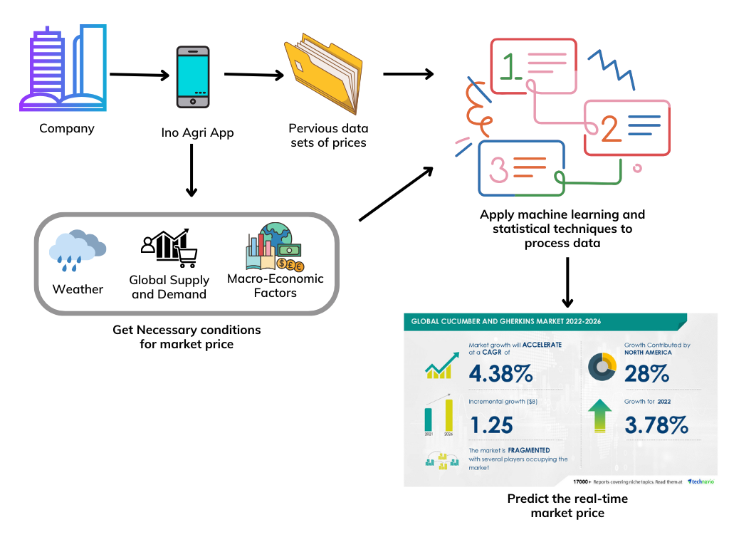
Component Diagram
IT21045530 | Nissanka K G T R K | R24-010

Slide 43

Novelty
Predict the market price for gherkins country-wise using historical data, weather, global supply and demand, and economy.
IT21045530 | Nissanka K G T R K | R24-010

Slide 44
Completion of the project
Process | Dec | Jan | Feb | Mar | Apr | May | Jun | Jul | Aug | Sep | Oct | Nov
Research group formation
Selection of research topic
Feasibility and background study
Supervisor and co-supervisor selection
Topic registration
Topic assessment submission
Project charter submission
Proposal presentation
Proposal report submission
Implementation of the project(50%)
Progress presentation 01
Prepare and submit research paper
Implementation of the project(90%)
Progress presentation 02
Project completion
Final Presentation
Final Report
IT21045530 | Nissanka K G T R K | R24-010

Slide 45
References
[1] Amod Murkute, Tanuja Sarode,” Forecasting Market Price of Stock using Artificial Neural Network ” Mumbai, India, 2015
[2] | Vikas Deswal, Dr. Dharminder Kumar, Dr. Suman, “Stock Market Price Prediction using Machine Learning Techniques” , in CISES 2013
[3] E. F. Fama, “CFA Institute Random Walks in Stock Market Prices,” Source Financ. Anal. J., vol. 51, no. 1, pp. 75–80, 2014.
IT21045530 | Nissanka K G T R K | R24-010

Slide 46
Work Breakdown Structure
Synergetic Innovation in Gherkin Cultivation
PP1
PP2
Project Group Registration
Project Proposal
Finalize Stage
Select Supervisors
Online Group Registration
Collect Data , research papers and clearly identify the research problem , gap , novelty in pre production
TAF Submission
Discuss and get the guidance from the supervisors
Collect More domain knowledge and more researches
research on implementation and steps
Prepare Proposal Report
Proposal Report Submission
Get the consultation from the supervisors
Implement the 50 % of the system
PP1 presentation
Get the guidance for the final stages
Complete 90% of the component
Prepare and finalize the research paper
Submit the research paper
Complete 100% of the implementation overall performance , finalization of entire system
Final presentation
Submit Status Report
Submit the log report

Slide 47
Thank you.

